Slide 1
Search Methodologies
Artificial Intelligence
Notes:
What are the fundamental Scientific Questions?
How did the Universe start?
Genome
AI
Theory for each, except AI..
GO OVER SYLLABUS
HAND OUT SEATING CHART

Slide 2
Problem solving as Search
Problem solving is an important aspect of Artificial Intelligence
A problem can be considered to consist of a goal and a set of actions that can be taken to lead the goal
At any given time we consider the state of the search space to represent where we have reached as a result of the actions we have applied so far.

Slide 3
To build system that solves the problem
  Define the problem: must include precise specifications ~ initial solution & final solution.
  Analyze the problem: select the most important features that can have an immense impact.
  Isolate and represent : convert these important features into knowledge representation.
  Problem solving technique(s): choose the best technique and apply it to particular problem.

Slide 4
What is Search?
Search is a method that can be used by computers to examine a problem space in order to find a goal.
Often we want to find the goal as quickly as possible or without using too many resources.
Search Space is the problem space since we search the space for a goal state, in order to solve the problem.

Slide 5
Data-Driven or Goal-Driven Search
Data-driven search starts from an initial state and uses actons that are allowed to move forward until a goal is reached.
( Top-down approach)
Goal-driven search starts from the goal and work back towards a state, by seeing what actions could have led to the goal state.
(Bottom-up approach)

Slide 6
Why is search interesting?
Many (all?) AI problems can be formulated as search problems!
Examples:
Path planning
Games
Natural Language Processing
Machine learning
Genetic algorithms

Slide 7
Generate and Test
Example technique: generate-and-test.
Generate a possible solution.
Test the solution.
If solution found THEN done ELSE return to step 1.
Simply involves generating each node in the search space and testing it to see if it is a goal node.

Slide 8
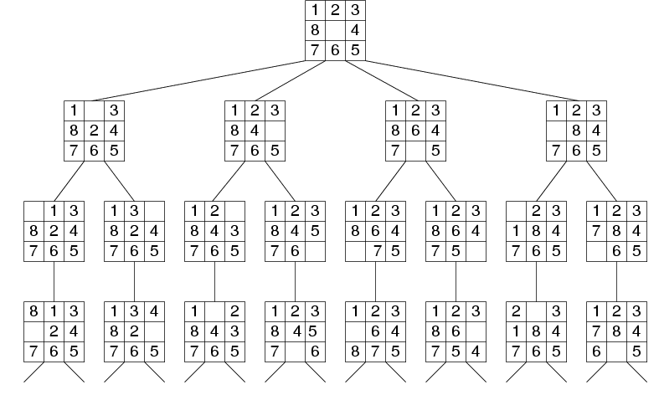
Search Tree Example:
Fragment of 8-Puzzle Problem Space

Slide 9
Search thru a Problem Space / State Space
  Input:
  Set of states
  Operators [and costs]
  Start state
  Goal state [test]
  Output:
  Path: start ⇒ a state satisfying goal test
  [May require shortest path]
Notes:
State Space Search is basically a GRAPH SEARCH PROBLEM
STATES are whatever you like!
OPERATORS are a compact DESCRIPTION of possible STATE TRANSITIONS – the EDGES of the GRAPH
May have different COSTS or all be UNIT cost
OUTPUT may be specified either as ANY PATH (REACHABILITY), or a SHORTEST PATH

Slide 10
Search Strategies
Blind Search
  Depth first search
  Breadth first search
  Iterative deepening search
  Iterative broadening search
Informed Search
Constraint Satisfaction
Adversary Search

Slide 11
Properties of Search Methods
Complexity
  How efficient over time and space (memory)
Completeness
  Guaranteed to find a goal if one exists.
Optimality & Admissibility
  Guaranteed to find the best solution that exists. Admissibility is used in place of optimality when solution is to be found in quickest time.
Irrevocability
  Never back-tracks Those capable of backtracking are called Tentative.

Slide 12
Searching
2 Terms to be understood for searching
a) Visiting a node: Going on a particular node
b) Exploration of a node: Visiting all the
adjacent nodes of a node

Slide 13
Depth First Search
Maintain stack of nodes to visit
Evaluation
  Complete?
  Not for infinite spaces
  Time Complexity?
  O(b^d)
  Space Complexity?
  O(d)
  Optimality
  No
a
b
e
c
d
f
g
h

Slide 14
Breadth First Search
Maintain queue of nodes to visit
Evaluation
  Complete?
  Time Complexity?
  Space Complexity?
  Optimality
Yes
a
O(b^d)
b
c
O(b^d)
d
e
f
g
h
Yes

Slide 15
Iterative Deepening Search
DFS with limit; incrementally grow limit
Evaluation
  Complete?
  Time Complexity?
  Space Complexity?
  Optimality
Yes
a
b
e
O(b^d)
c
f
d
i
O(d)
g
h
j
k
L
Yes

Slide 16
Cost of Iterative Deepening
b | ratio ID to DFS
2 | 3
3 | 2
5 | 1.5
10 | 1.2
25 | 1.08
100 | 1.02

Slide 17
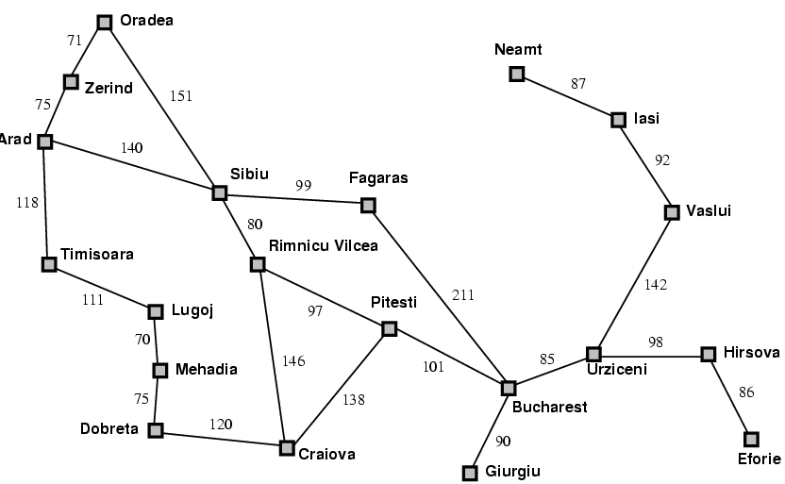
Forwards vs. Backwards
start
end

Slide 18
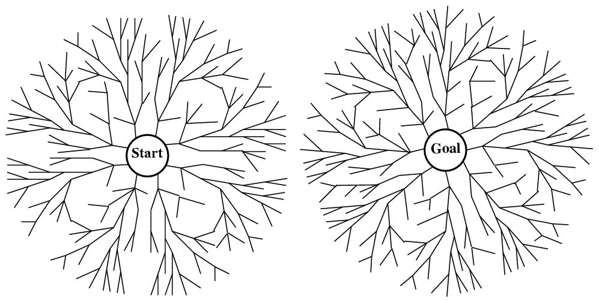
vs. Bidirectional

Slide 19
Problem
All these methods are slow (blind)
Solution → add guidance (“heurstic estimate”)
→ “informed search”

